Slide 1
St Vincent College offers a range of courses for practitioners and parents
Three strands, Academic, CPD and Wellbeing

Slide 2
Many courses are FREE
Wellbeing and CPD / Parent courses are free for people
earning less than £17,374.50 annual gross salary
Unemployed, seeking support into work or education
Ex-offenders on a supported programme
Older people in supported housing and care homes
Young people (under 25) who have been in or are leaving care and are currently not in education or employment.
If you do not meet this criteria costs are just £3 per hour

Slide 3
Practitioner wellbeing
SOME EXAMPLES:
Promoting women’s wellbeing and self esteem (10 weeks)
Eating well for good mental health ( 10 weeks)
Guided meditation (8 weeks)
Promoting men’s wellbeing and self esteem (10 weeks)
Positive manifestation (6 weeks)
Assertiveness skills (8 weeks)
Introduction to understanding nutrition and healthy eating (6 weeks)

Slide 4
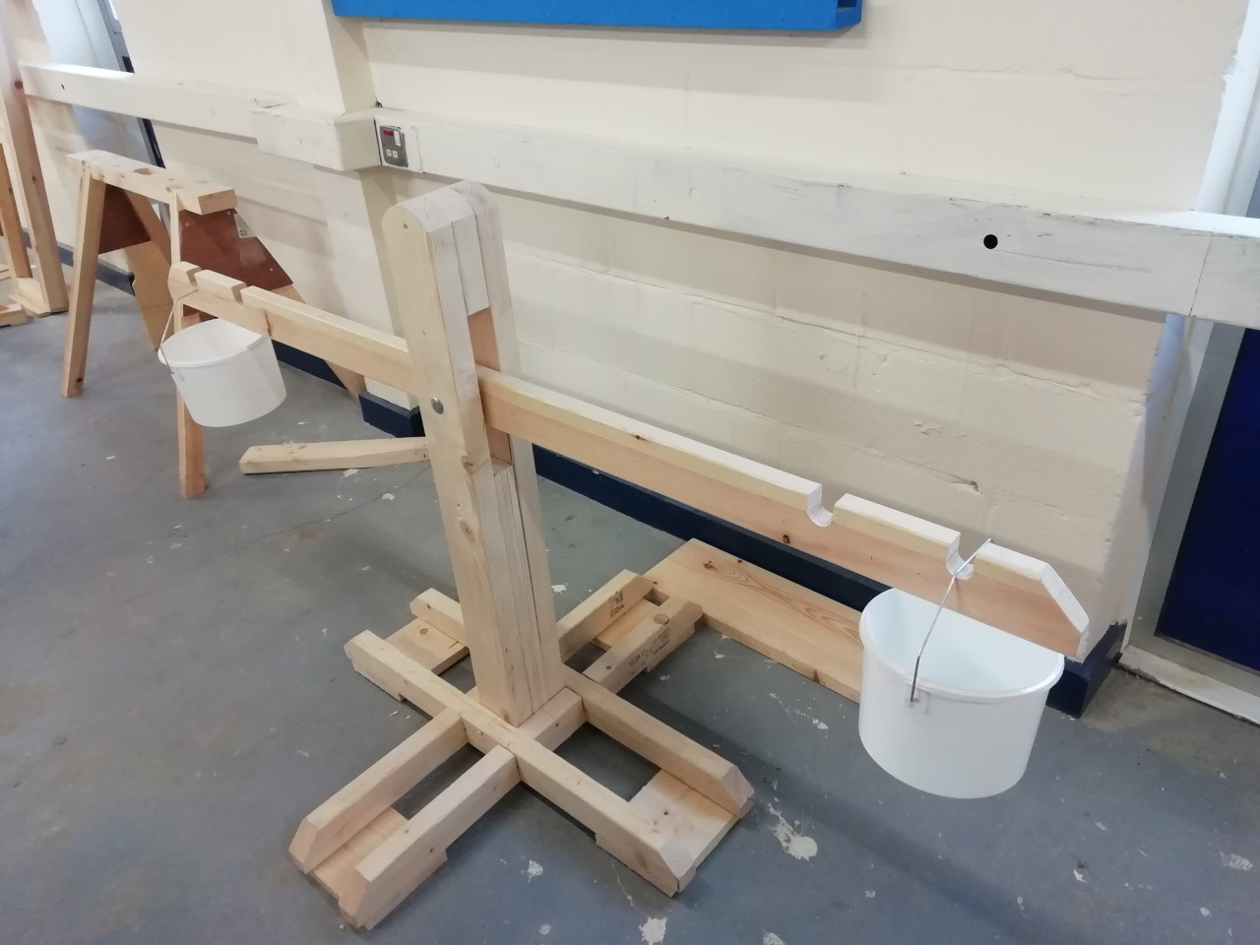

Slide 5
CPD/ Short courses for parents
Introduction to healthy eating for children’s development (4 weeks)
Introduction to children’s health and wellbeing (4weeks)
Introduction to reading with children (4 weeks)
Introduction to learning through play in the early years (4 weeks)
Introduction to sharing bedtime stories with your children (4 weeks)
Introduction to early years (5 weeks)
Introduction to children’s speech and language needs (4weeks)
Introduction to child psychology
First Aid – basic life support (4 weeks)
First Aid – parent and child (4 weeks)

Slide 6
Academic courses
EYE – early years educator level 3 – FREE if you are over 19 and do not already have a current level 3 qualification
GCSE Maths and English – FREE
Paediatric first aid – onsite or we can deliver at your setting.
Early Years Foundation degree – level 4 and 5 – studied at St Vincent in conjunction with the University of Portsmouth Student finance available

Slide 7
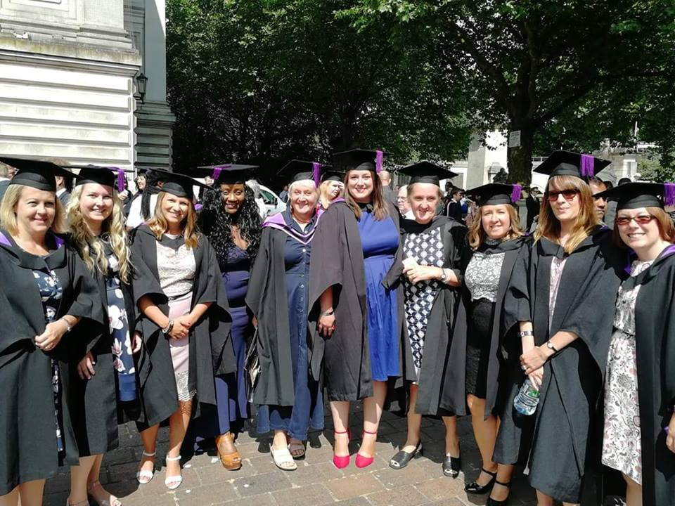
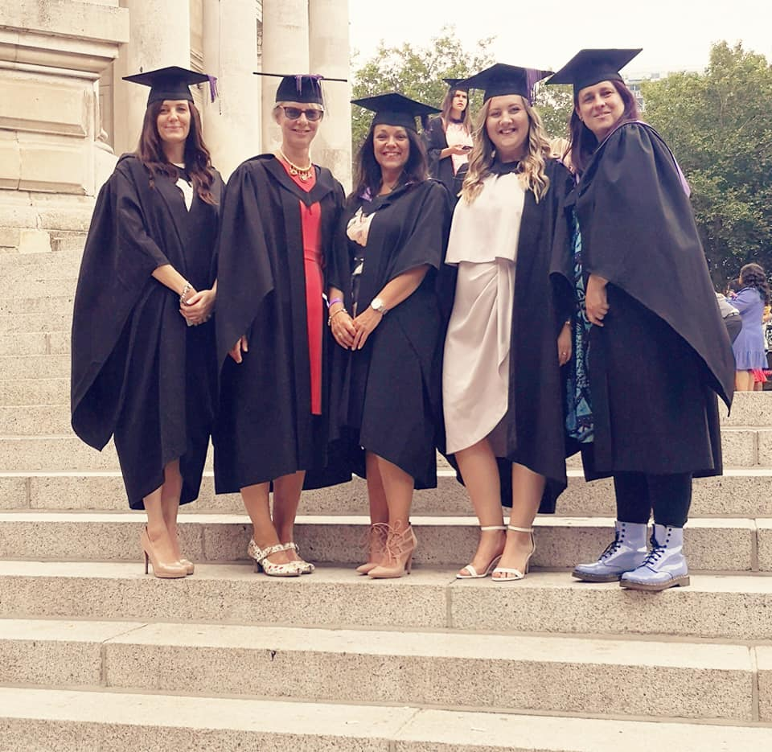
This is just a taste of our full offer…
More details are available on our website.
Or Call: 023 9258 8311 Email: info@stvincent.ac.uk

